Slide 1

What are soft skills anyway?
MGMT 1103

Slide 2

Soft skills

Slide 3
Definition

Slide 4

SOFTSKILL#1

Slide 5
Definition

Slide 6

SOFTSKILL#2

Slide 7

SOFTSKILL#3

Slide 8
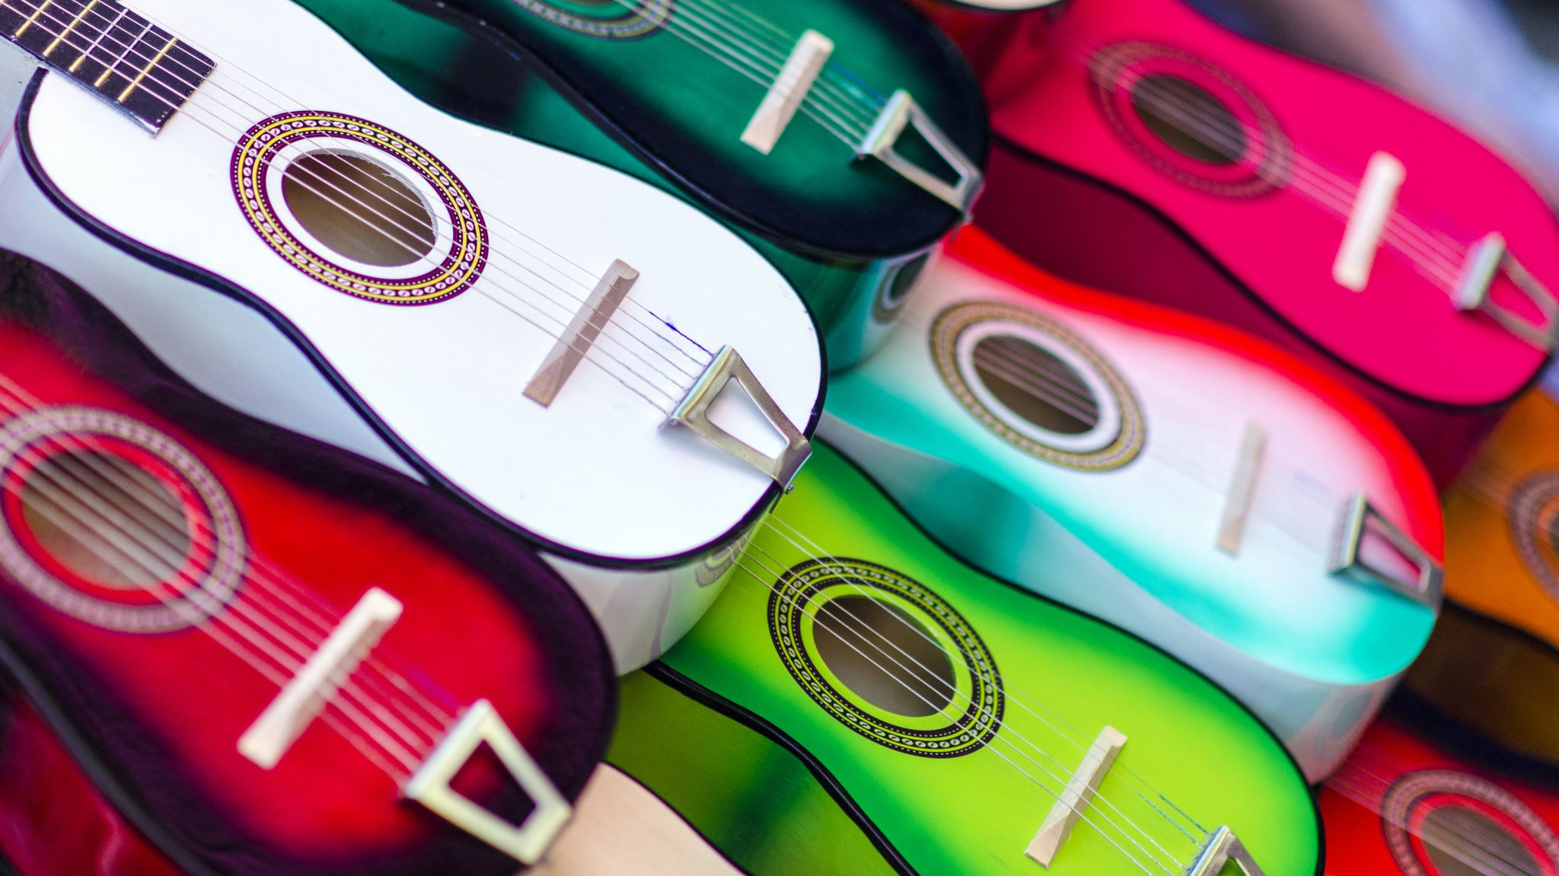
SOFTSKILL#4

Slide 9

SOFTSKILL#5

